Slide 1

WISards Team DDI Challenge
Noa Raindel, Daphna Regev, Dikla Gelbard Solodkin,
Shira Kritchman, Chen Attias
Weizmann Institute of Science and Wizardry

Slide 2
Insights on Data Structure
Small world phenomenon
Average shortest path between 2 nodes is
Maximal shortest path between 2 nodes is
Scale-free effect
Most nodes have only a few links
A small number of hubs that have many links
Power law distribution
Giant connected component

Slide 3
Insights on DDI Data
Two drugs interact when
They cause each other to be ineffective
Their combination is harmful
The nature of the interaction is determined by a latent space of the components that make up the drug

Slide 4
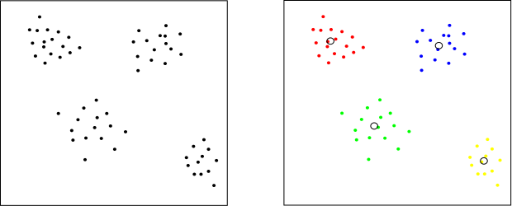
Cross Cluster Similarity

Slide 5
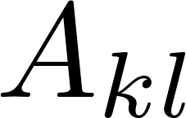
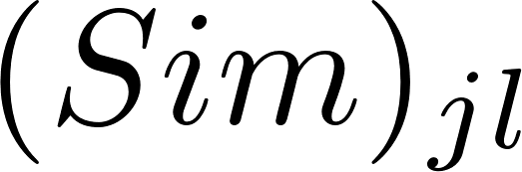
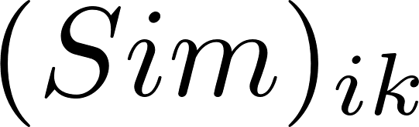
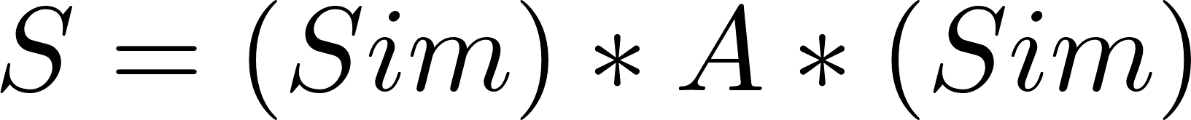
Sim-Conn
k
l
i
j
?

Slide 6
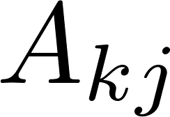
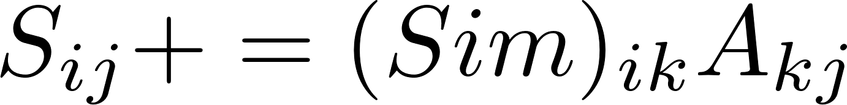
Sim-Conn
k
i
j
?

